Slide 1

Control Flow Statements

Slide 2
Topics
If, Else and Else if
Switch
While loop
Do While loop
For loop

Slide 3
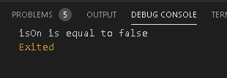
If ,Else & Else if
void main(List<String> arguments) {
bool isOn=false;
//Outter Scope
if(isOn){
//Inner Scope
print("isOn is equal to $isOn");
var ifOff=true;
}
else{
print("isOn is equal to $isOn");
}}

Slide 4

void main(List<String> arguments) {
int test=1;
//Outter Scope
if(test==2){
//Inner Scope
print("test equal to $test");
}
else if(test==1){
print("test equal to $test");
}
else{
print("test equal to $test");
}
}

Slide 5

Switch Case
void main(List<String> arguments) {
int test=0;
switch(test){
case 0:print("Switch test is zero");
break;
case 1:print("Switch test is one");
break;
default:print("Switch test is $test");
}
}

Slide 6
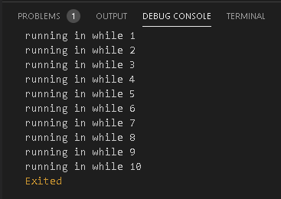
While loops
A while loop executes the condition before the loop
void main(List<String> arguments) {
int counter=0;
while(10>counter){
print('running in while ${counter+1}');
counter++;
}
}

Slide 7
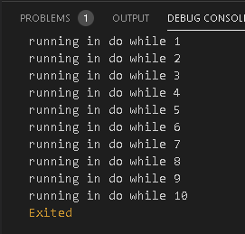
Do While Loop
Executes the condition after the loop
void main(List<String> arguments) {
int counter=0;
do{
print('running in while ${counter+1}');
counter++;
}while(10>counter);
}

Slide 8
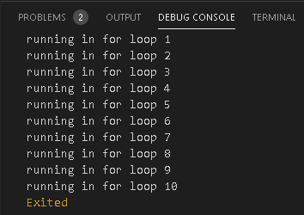
For loop
void main(List<String> arguments) {
for(int counter=0;counter<10;counter++){
print("running in for loop ${counter+1}");
}
}

Slide 9
Thank You !!

